Slide 1
Assess HP1 bound chromatin during aging
How many / which RNA seq genes and ATAC peaks are up and down regulated

Slide 2
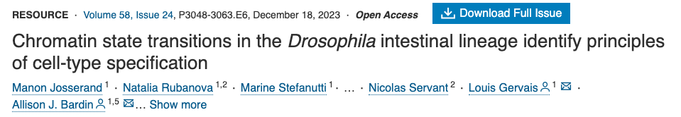
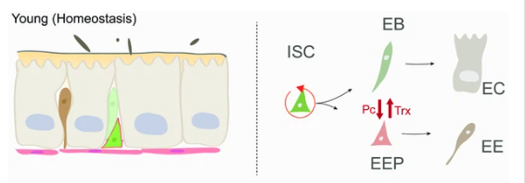
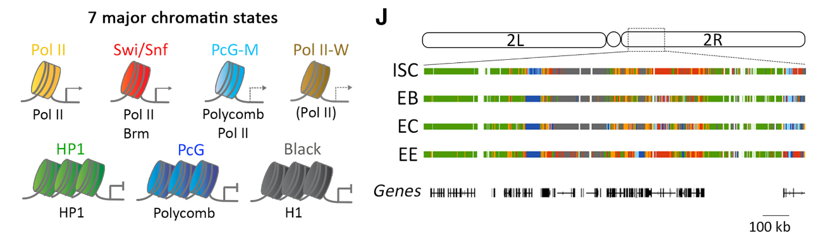

Slide 3
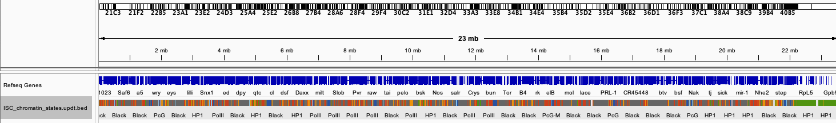
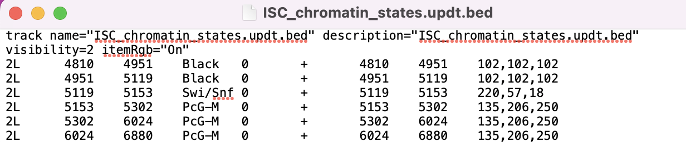
Get chromatin state tracks
Chromatin state tracks in ISC : https://github.com/gervlouis/Josserand_et_al
Will be a .bed file and can be opened in IGV

Slide 4
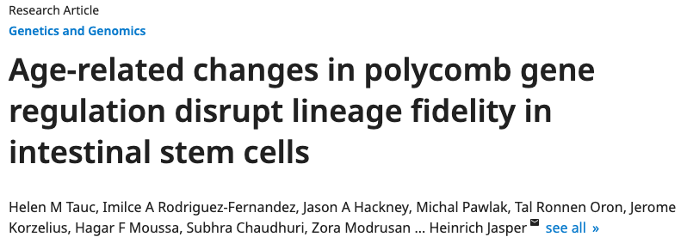
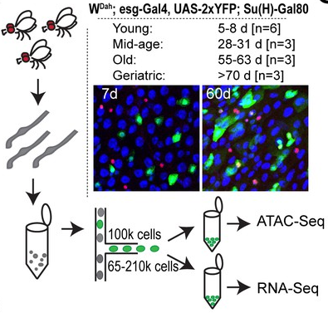
ATAC seq samples:
3x young
2x mid
3x old
https://www.ncbi.nlm.nih.gov/geo/query/acc.cgi?acc=GSE164317
RNA seq samples:
7x young
3x mid
3x old
3x very old
https://www.ncbi.nlm.nih.gov/geo/query/acc.cgi?acc=GSE157796

Slide 5
Are genes / ATAC peaks in heterochromatin differently affected by aging compared to the rest of the genome?
Heterochromatin is lost during aging
Hypothesis with increased age
more open chromatin?
more genes transcribed?
Hypothesis with increased age
no clear trend?

Slide 6
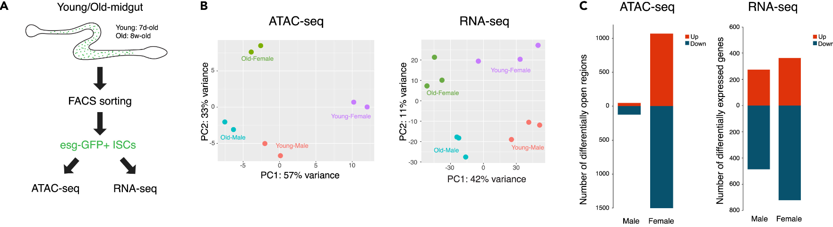
Use ATAC-seq to assess whether HP1-bound chromatin is more open / closed during aging
Remap FASTQ files to reference genome
Check per chromatin state how many peaks are gained and lost during ageing (compare young vs middle vs old)
Etc …
PolII chromatin
HP1-chromatin
Gavin

Slide 7
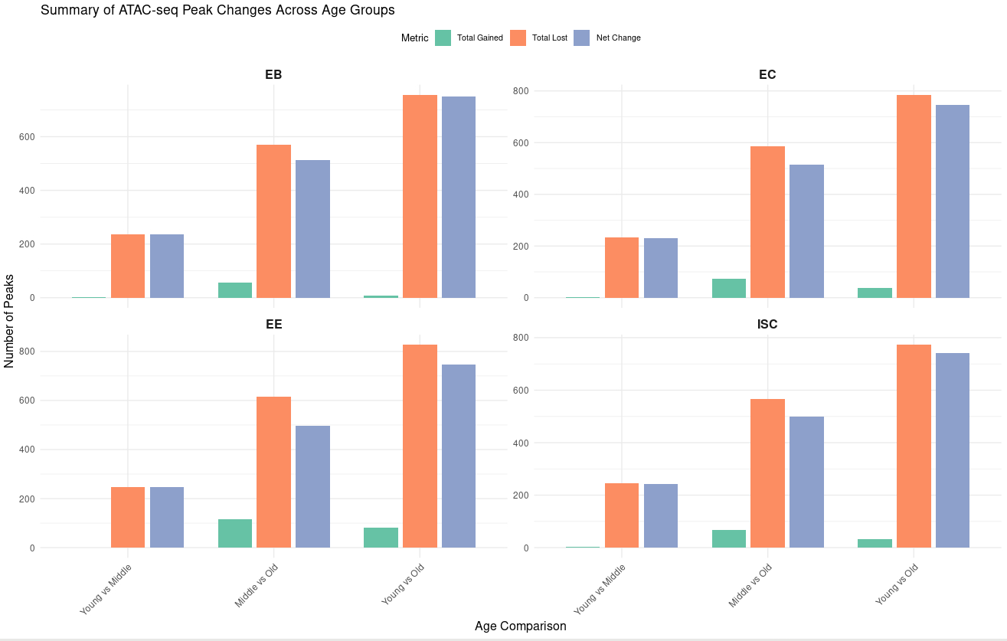
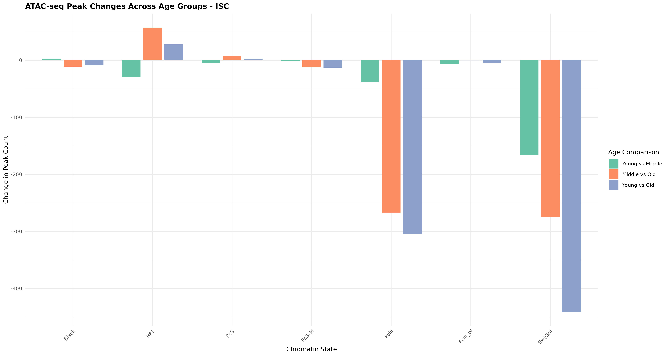
Gavin

Slide 8
Use RNA-seq to assess whether HP1-bound chromatin is more active / silenced during aging
Remap FASTQ files to reference genome
Assign the chromatin state for every gene (based on predominant state covering the entire gene in young ISCs)
Check per chromatin state how many genes are up- and downregulated during ageing (compare young vs middle vs old vs very old)
Etc …
PolII chromatin
HP1-chromatin

Slide 9
Data sets to use:
Chromatin state tracks in ISC from Allison Bardin (young)
https://github.com/gervlouis/Josserand_et_al
ATAC seq ISCs wDah from Heinrich Jaspers (young vs old)
https://www.ncbi.nlm.nih.gov/geo/query/acc.cgi?acc=GSE164317
RNA seq ISCs wDah from Heinrich Jaspers (young vs old)
https://www.ncbi.nlm.nih.gov/geo/query/acc.cgi?acc=GSE157796

Slide 10
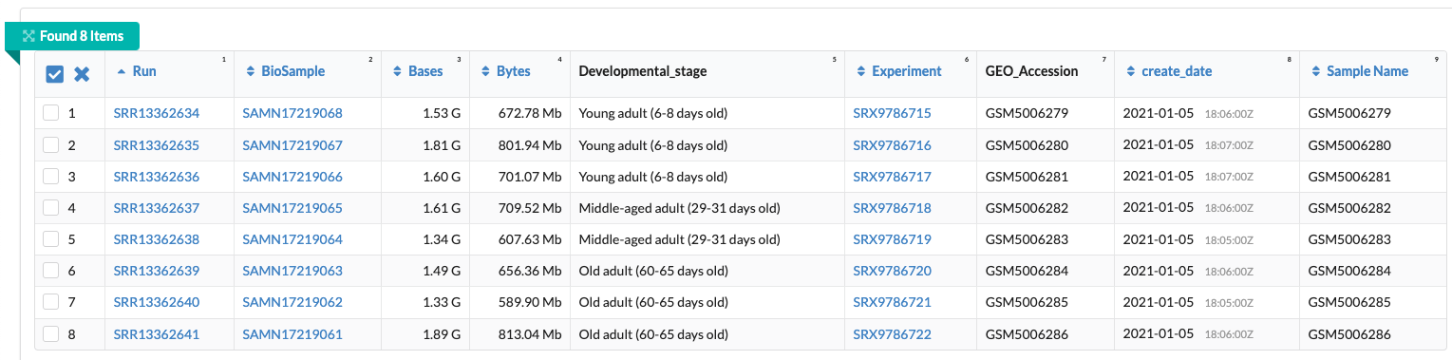
Get FASTA or FASTQ files from ATAC seq
Go to website: https://www.ncbi.nlm.nih.gov/geo/query/acc.cgi?acc=GSE164317
Copy SRA number (SRP300536)
Paste number in SRA Run selector : https://www.ncbi.xyz/Traces/study/
Bottom: click at specific run number (starting with SRR)
Top new page: click at FASTA/FASTQ download
Download FASTQ files because this is after quality control
Compare to newest drosophila genome (release 6 ?)

